Slide 1
Computational Practical 6
Detecting antimicrobial resistance from bacterial genomes using command-line tools
Antimicrobial Resistance of Bacterial Pathogen Course
Johannesburg, South Africa
10/03/2026

Slide 2

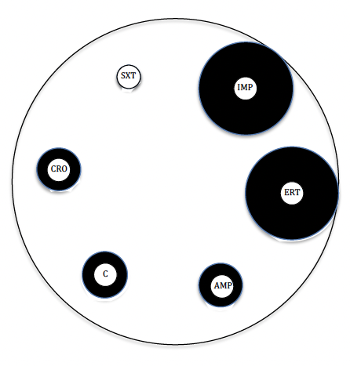
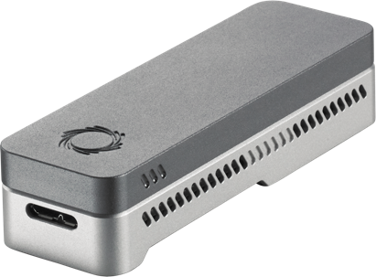
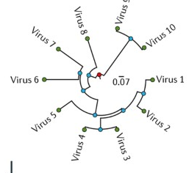

Sample collection
Phenotypic AST
WGS and QC
Genotypic AST
Phylogenetic analyses
Data integration
Metadata design and collection
Isolation, culture, disc diffusion
Illumina & ONT, genomic QC
AMR bioinformatic detection and metagenomics
Alignment and variant calling, phylogenetic reconstruction
Epicollect, Microreact
S
A
G
A
P
I
Epicollect
LP1
LP2, CP1, CP2
CP6, CP7, CP8
CP3, CP4, CP5,
CP9, CP11
CP10, GP

Slide 3
Sample collection
Phenotypic AST
WGS and QC
Genotypic AST
Phylogenetic analyses
Data integration
Metadata design and collection
Isolation, culture, disc diffusion
Illumina & ONT, genomic QC
AMR bioinformatic detection and metagenomics
Alignment and variant calling, phylogenetic reconstruction
Epicollect, Microreact
S
A
G
A
P
I
Epicollect
LP1
LP2, CP1, CP2
CP6, CP7, CP8
CP3, CP4, CP5,
CP9, CP11
CP10, GP

Slide 4
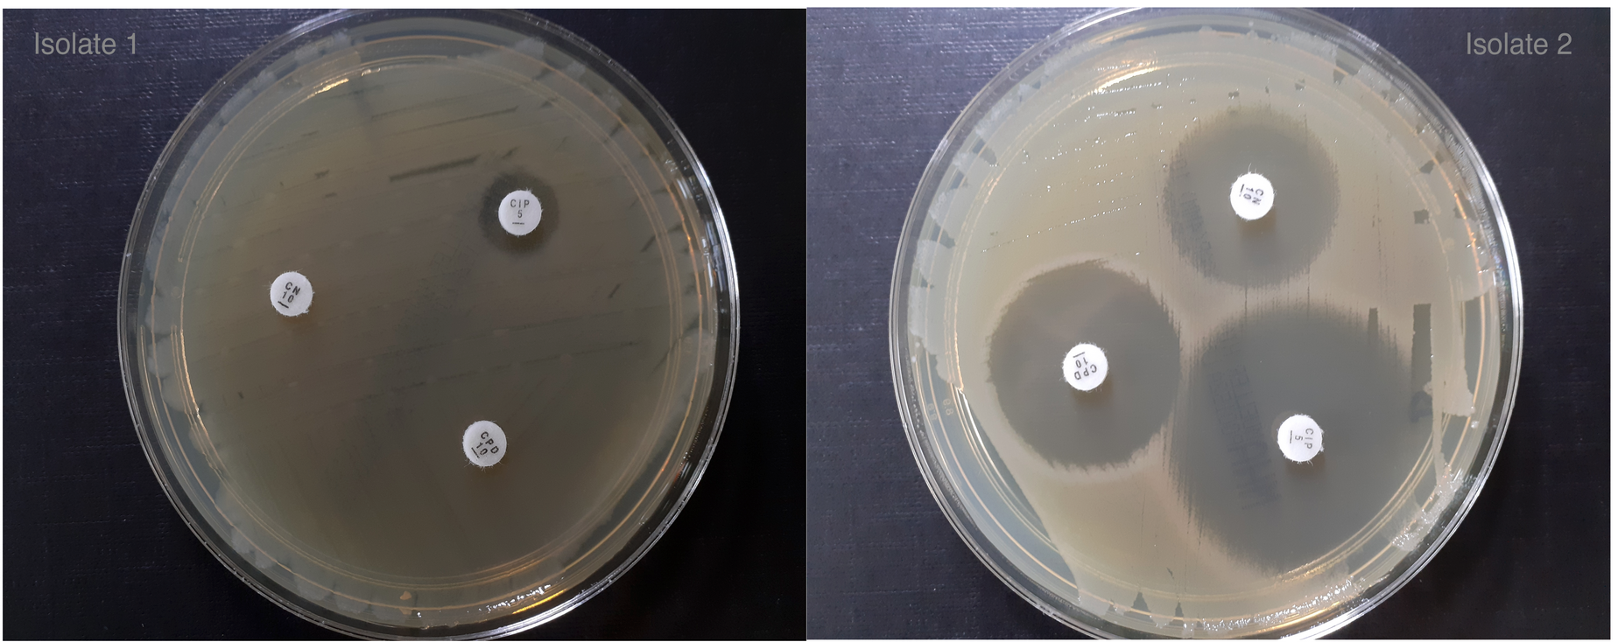
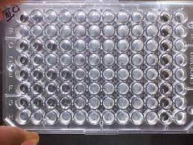
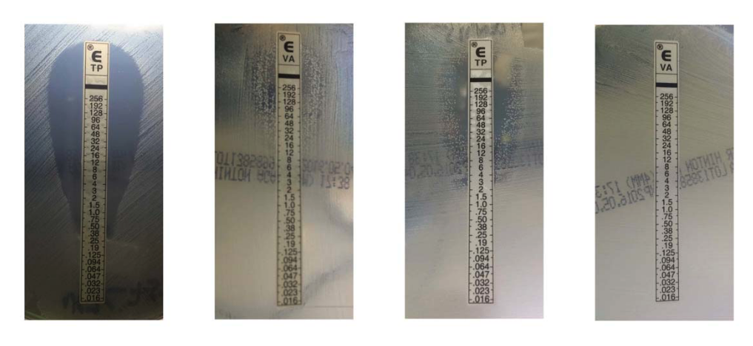
Commercial phenotypic AMR detection assays
Routine culture-based AST
AST is routinely performed using culture-based methods, such as disk diffusion, broth microdilution or gradient diffusion (the E-test).
Disk diffusion
Broth microdilution
E-test

Slide 5
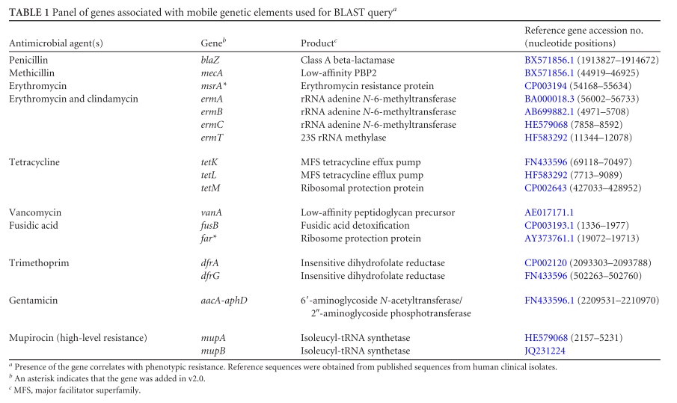
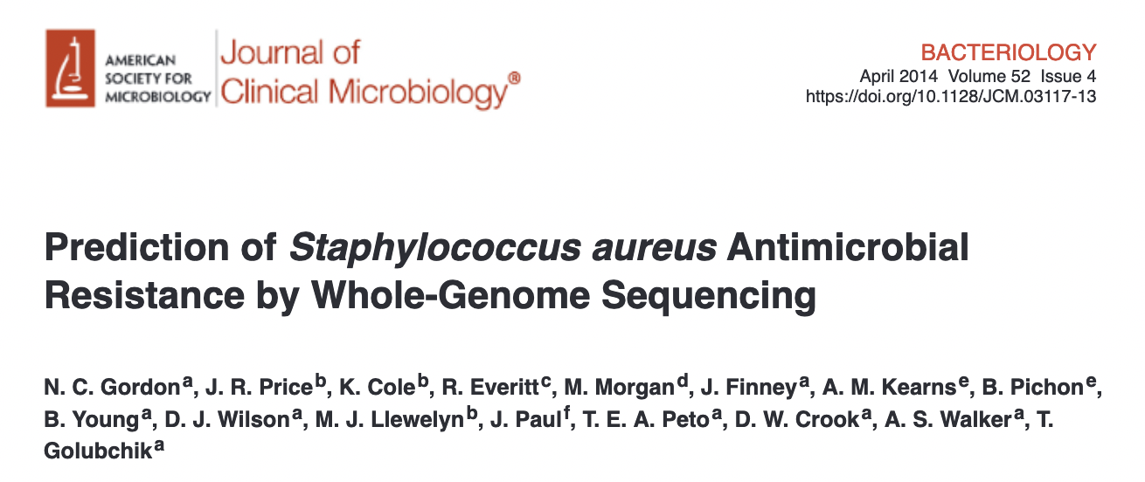
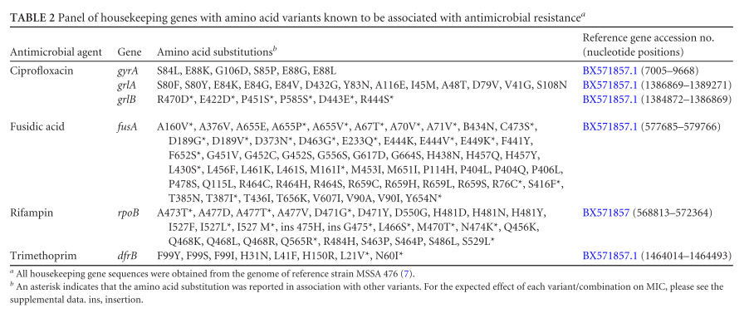
Approaches for AMR genotypic determination
Look-up table and rule-based approaches
Gordon, N. C. et al. Prediction of Staphylococcus aureus Antimicrobial Resistance by Whole-Genome Sequencing. Journal of Clinical Microbiology 52, 1182–1191 (2014).

Slide 6



Available databases and tools
https://github.com/arpcard/rgi
https://github.com/ncbi/amr (AMRFinderPlus)
https://github.com/cadms/resfinder

Slide 7
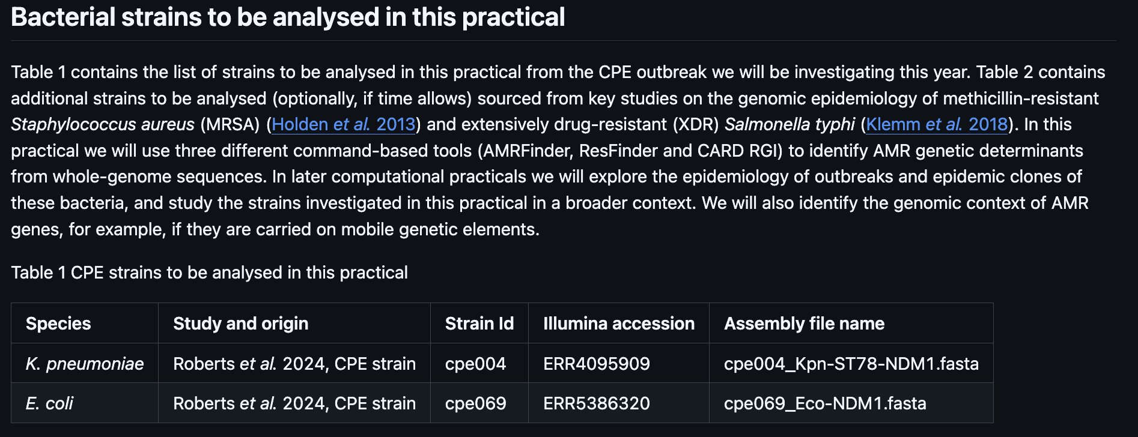
Outbreak strains genomes to analyse

Slide 8
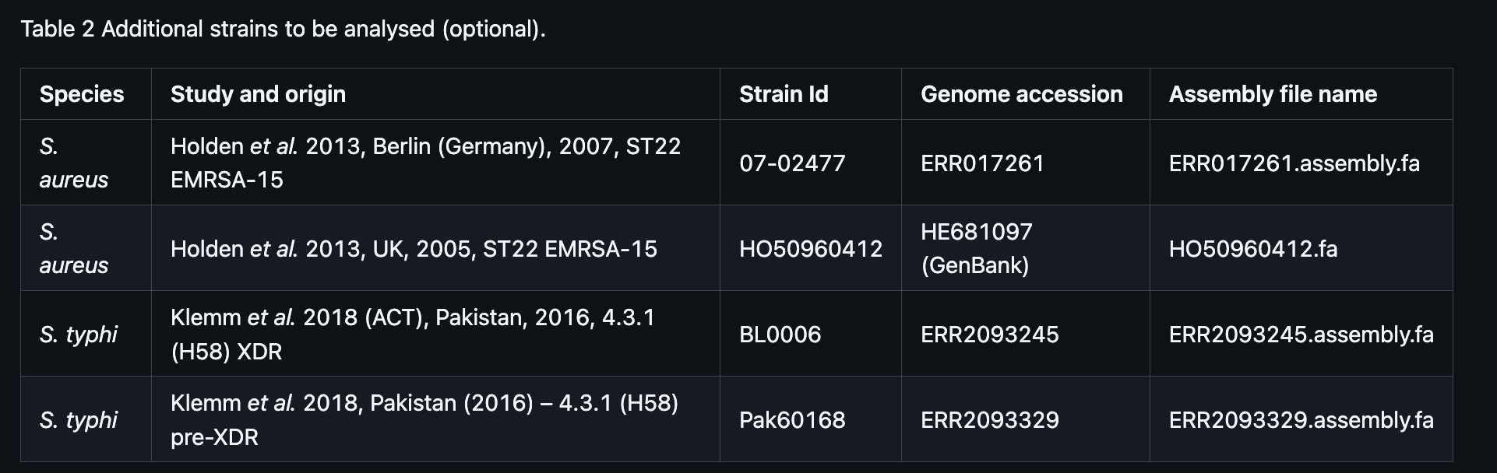
Outbreak strains genomes to analyse

Slide 9
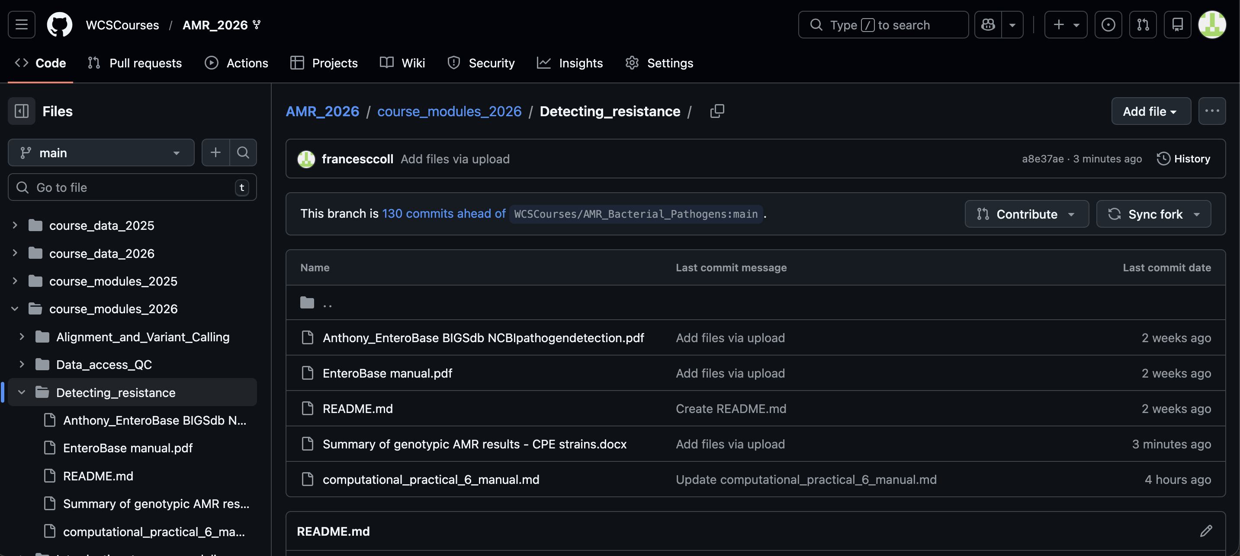
https://github.com/WCSCourses/AMR_2026/tree/main/course_modules_2026/Detecting_resistance/

Slide 10
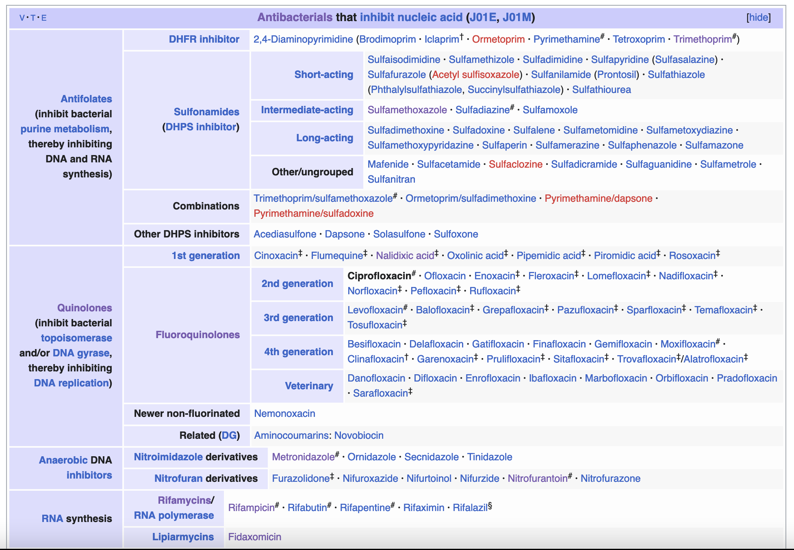
When interpreting the results: link antibiotic to antibiotic class
https://en.wikipedia.org/wiki/Ciprofloxacin

